Slide 1
Home Pet Automation System
SIT210 - Daniel Maddern - 221004619

Slide 2
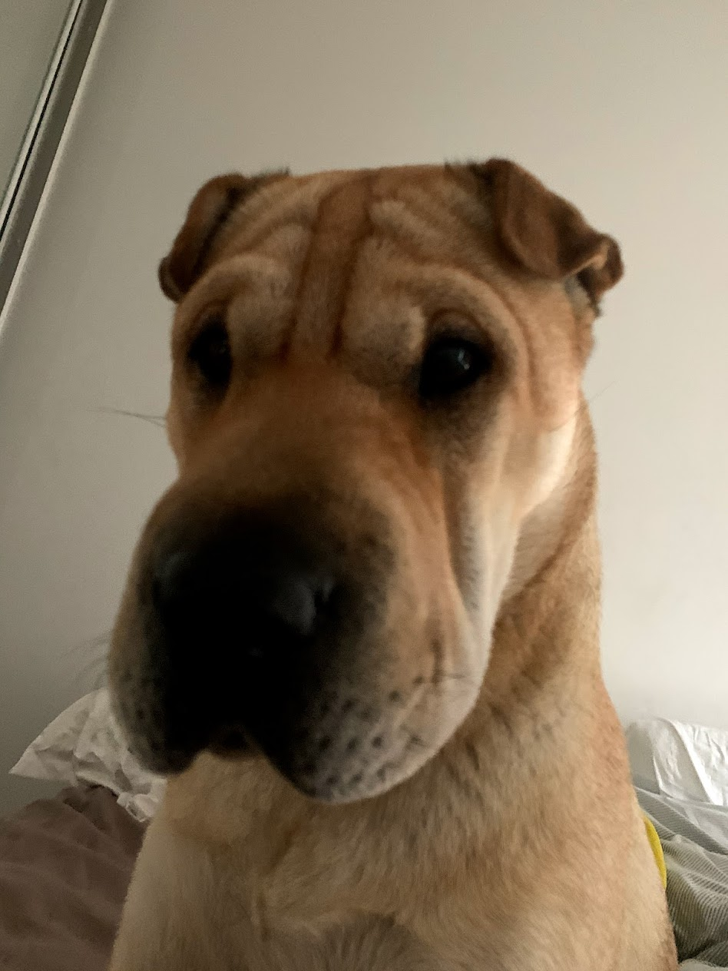
Real World Problem
Household pets are very important to a lot of people. They are like members of the family and often people have to leave them alone at home while they go to work.
We have a lot of household automation that is very convenient but can affect a pets wellbeing and often can cause destructive behaviour from the animal, for example a dog is in the living room at the same time the robot vacuum is trying to clean the house.
With living in Australia which is notorious for being a very warm country sometimes our animals are left at home with no air conditioning or cooling while they wait for us to return home.
Wouldn't it be great if we could somehow combine the automation of our home and the comfort of our pets…?

Slide 3
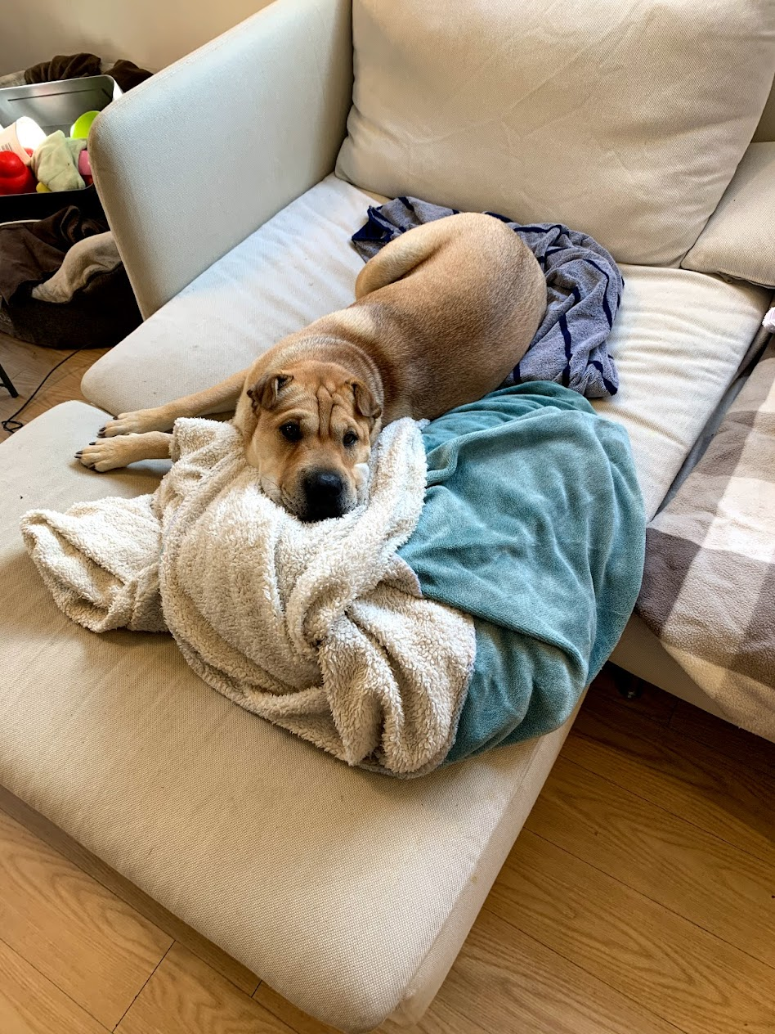
What solutions are currently available?
In this modern world there are many individual solutions for both home automation and for pet comfort but none that really combine the two facets.
For Home Automation we can have:
Smart Fans
Smart TVs
Smart Kettles
Robot Vacuums
Smart Blankets
For Pet Automation we can have:
Smart Pet Food dispensers
Smart Water dispensers
Smart Pet doors
However there are no solutions that tie all these things together based on what the Pet is doing at the time. They are either timer based or individually operated.

Slide 4
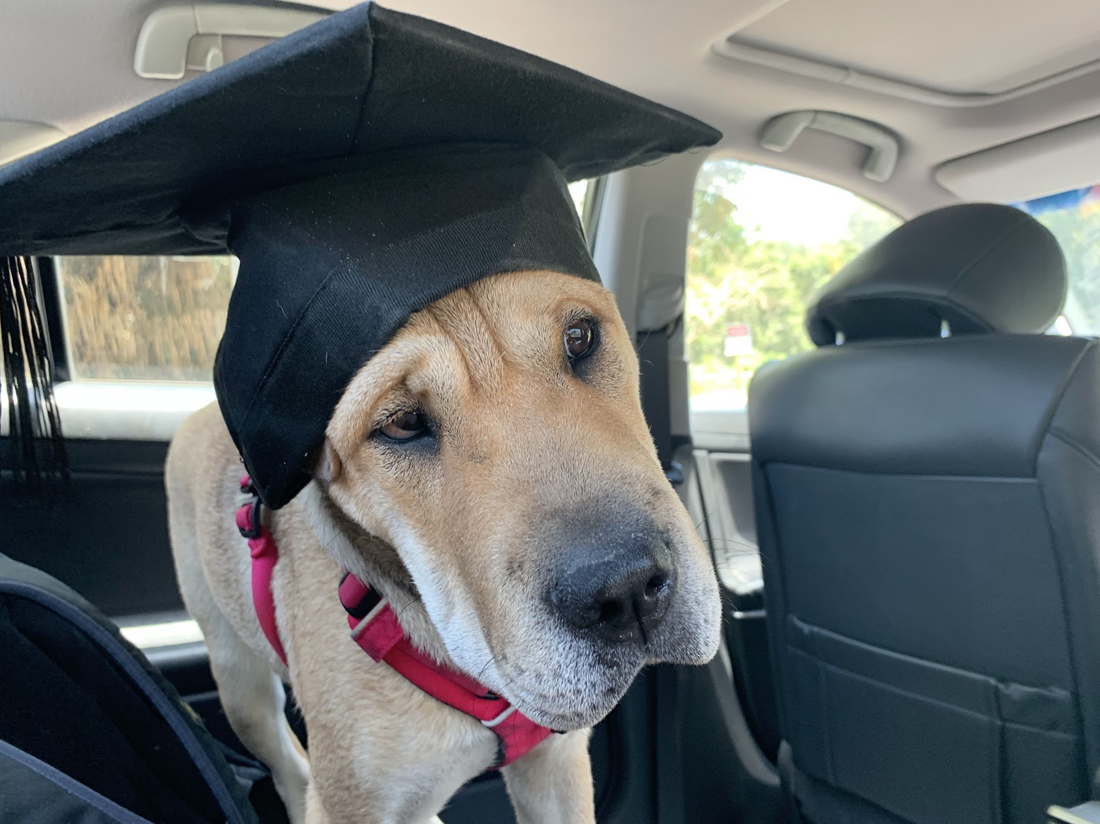
Problem Solution
The solution I am proposing is to create a system that can monitor the dogs position and the temperature in the house or apartment.
When the dog is in bed it can safely activate the Robot Vacuum knowing that it won't end up in a fight with the dog.
It can turn the smart fan on if the temperature gets too hot while keeping it off to save money and electricity if the dog is not in that area.
It can report all this information to the owner via email and to a simple website.
It can Allow manual override from the owner for each device.

Slide 5
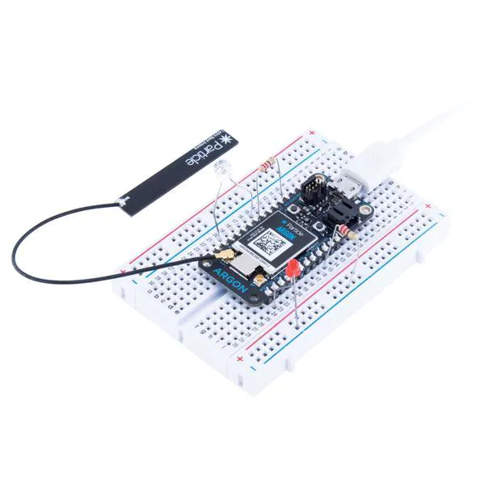
How will this be setup?
Firstly we will be using a Particle Argon with a Temperature sensor and Ultrasonic sensor connected, this will monitor the temperature in the dogs sleeping area and note when the dog leaves the room to go to other areas of the house. It will communicate with a second microcontroller If the temperature gets too high and the dog is within the room using IFTTT triggers the smart fan will come on, if the dog leaves the room the smart fan will turn off to save electricity and cost.
Also while the dog is in the room the Robot Vacuum will be able to run twice a day via IFTTT trigger, however at the point the dog leaves the room it will signal the robot vacuum to shutdown.
I have decided to make use of the IFTTT google home integration to make this possible as not all smart home devices allow direct API access to turn them on and off. I will be using a Xiaomi Smart Fan and Roborock S500 Robot vacuum as part of the system.

Slide 6
Reporting back to the owner
For owner notification we will look at a two tier approach, to ensure the owner gets the appropriate notifications and access.
Firstly the owner will get an email notification when one of these events are triggered.
Secondly we will report this information to a simple website and allow a manual override to the systems for the owner if required.

Slide 7

Future Developments
The best thing about this solution is that we can simply add more systems in to the home pet automation system, in the future we could add a water dispenser or food dispenser to the system.
We could look at only turning on the home video system when the pet is up and about rather than having it on all day.

